Slide 1
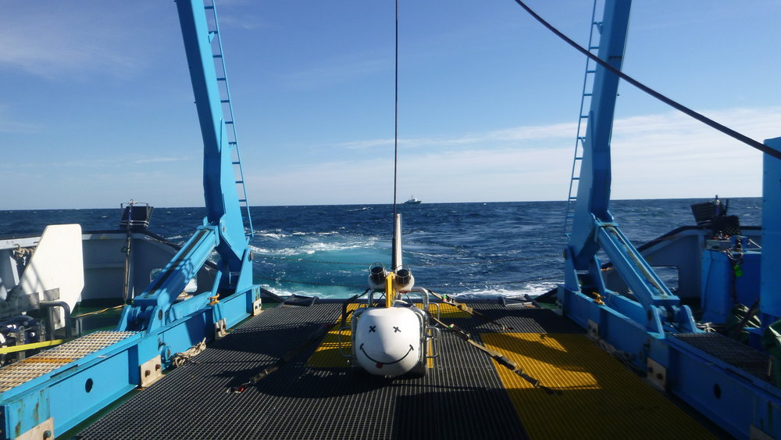
CSEM study on the Gekko well :

Slide 2
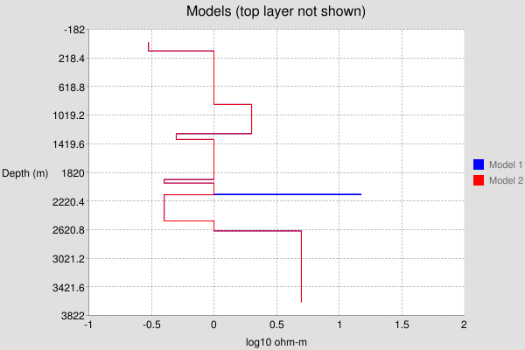
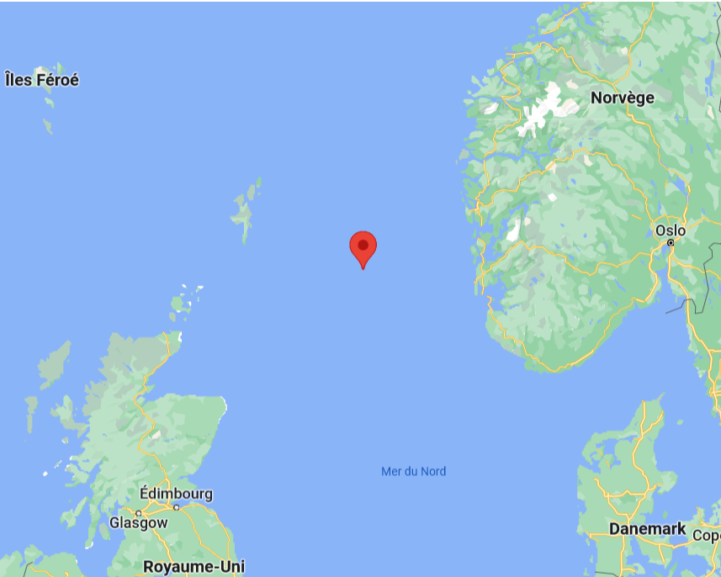
Deep-water : 121m
Reservoir deft : 2125m, thickness : 8m
Composition : tuff // 3m of gas + 5m of oil in Heimdal sand // water (Heimdal)

Slide 3
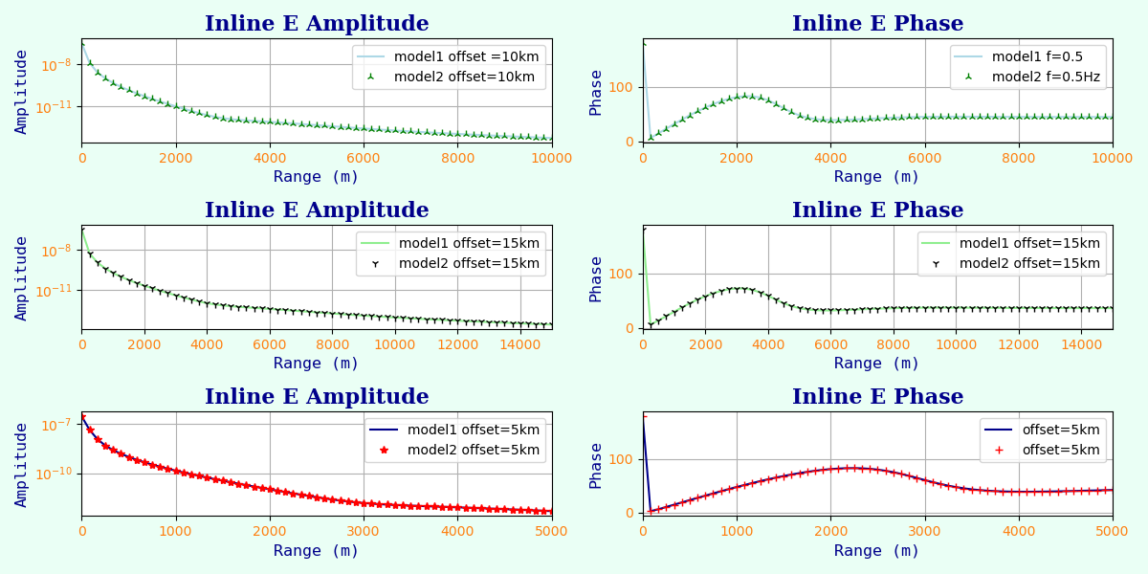
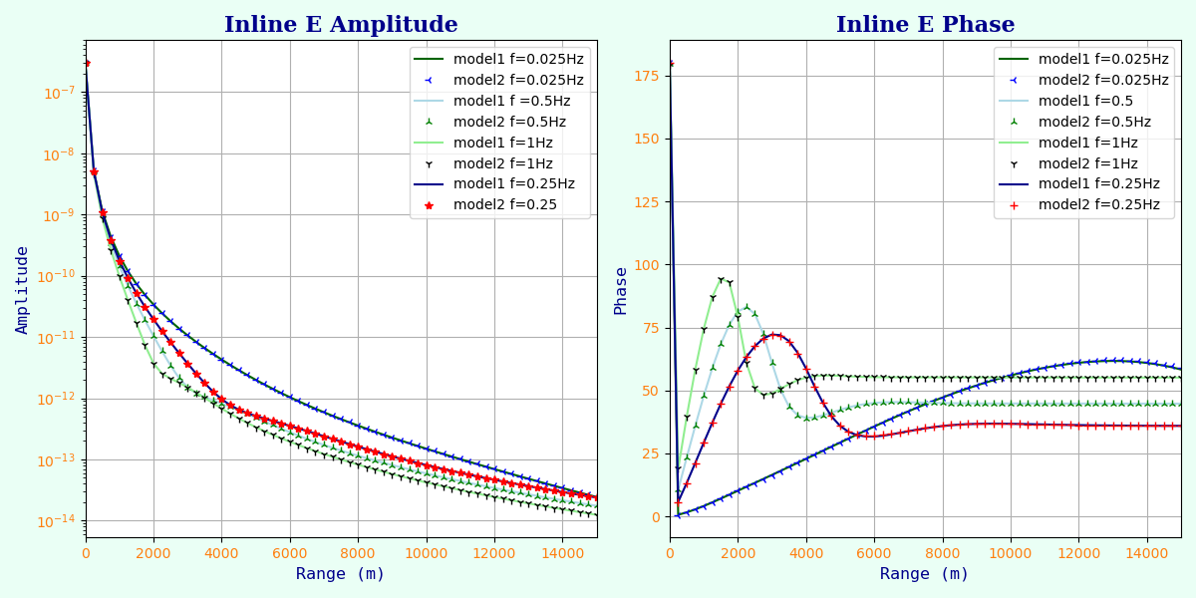
No relevant differences between offsets in Inline WITH and NO
The same lack difference for the frequencies.

Slide 4
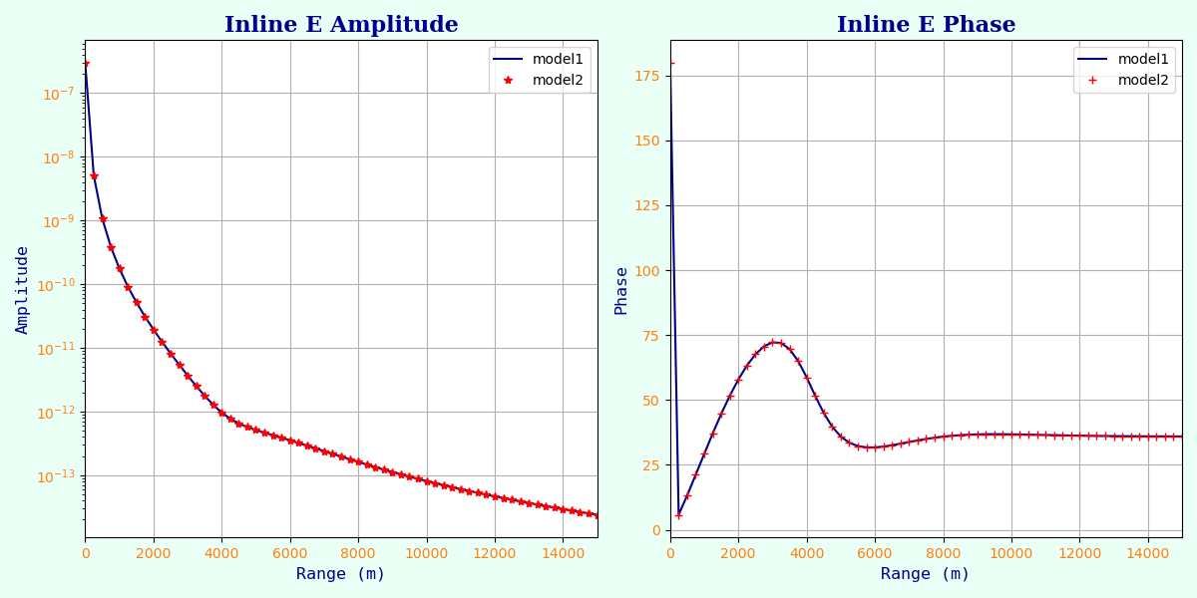
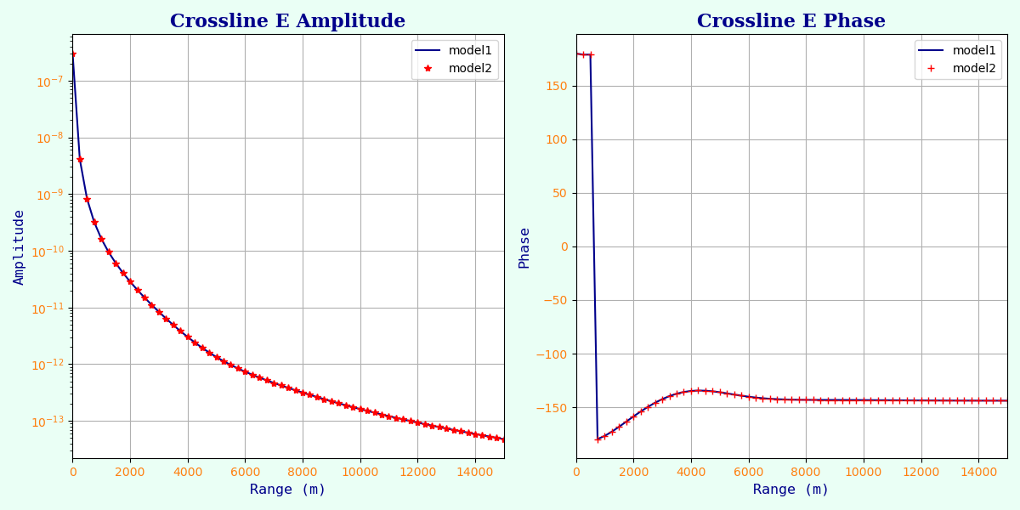
We choose an offset of 15000m and a frequency of 0,5Hz because it seems to be the most interesting plot.
There are also no huge differences between the Inline and Crossline curves. Only a little delay in phase, for the Inline, the peak is reach for 3000m and for the Crossline, for 4200m.

Slide 5
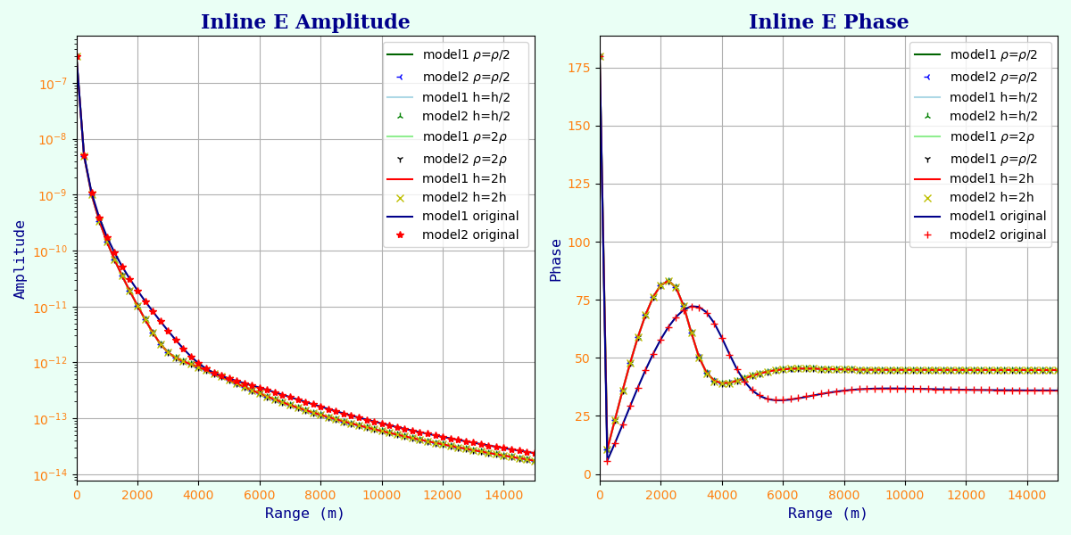
There are also no distinction between the different resistivity or thickness of the reservoir, it’s maybe due to the small real dimensions of the reservoir and to the low resistivity of the layer (only around 10 times more resistant).

Slide 6
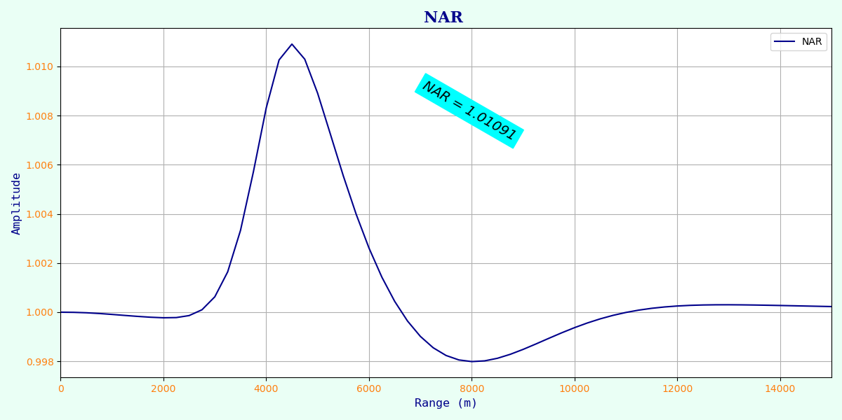
Hesthammer criterion : ~1,01 => 1% << 15% needed for a positive result.
The Hesthammer criterion is negative in our case, one more thing that suggests that the well isn’t exploitable.

Slide 7
Conclusion :
In our case, CSEM didn’t help to localize HC-bearing deposits, we could say that it helps us to know that the deposit isn’t relevant enough.
Indeed the reservoir is too small to have an influence on the measurement (8m max). As shown by the 1% Hesthammer criterion. In view of all these results, we advise not to continue the exploitation of the Gekko well.
WHAM supposes that the subsurface resistivity is 1D thus that we have infinite horizontal layers, which isn’t the case in reality. The influence of more conductive layers is then increased. So in our situation the reservoir layer must have a bigger influence than in reality which confirms our choice not to continue the exploitation of this well.

